Slide 1
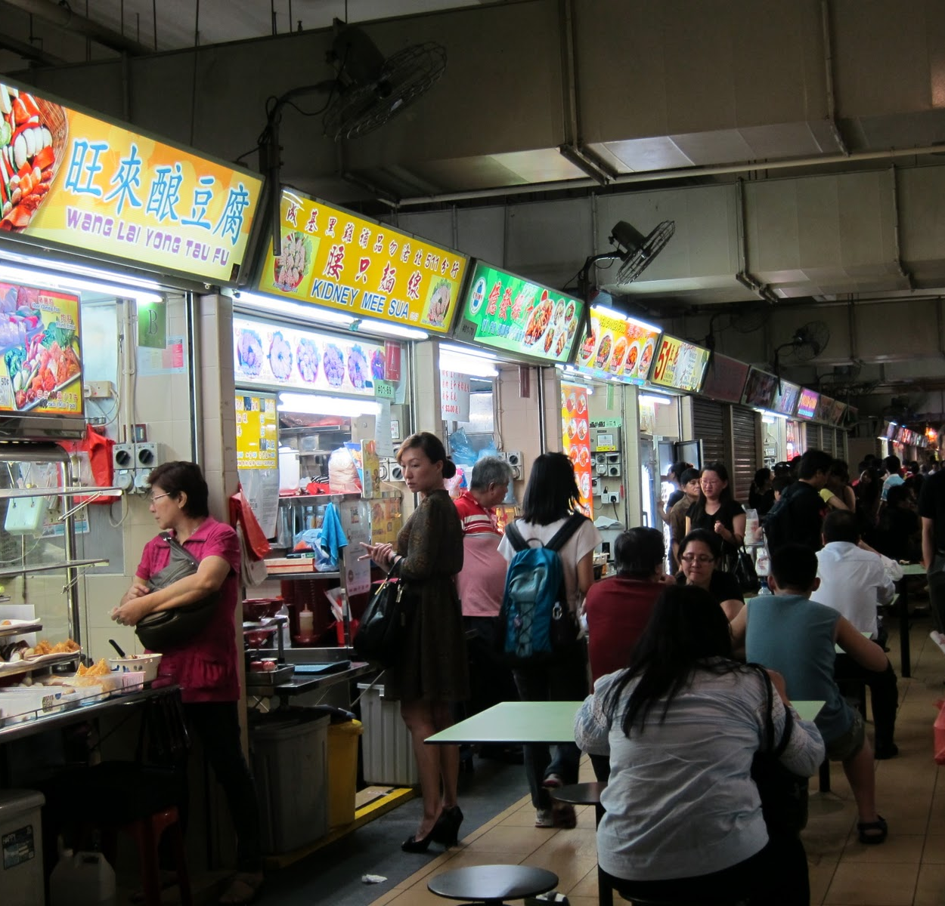
Singapore Hawker Food Classifier
By: Derrick Lim, DSI-21

Slide 2
TABLE OF CONTENTS
MODEL EVALUATION
04
01
BACKGROUND
02
DATA
LIMITATIONS
05
03
FUTURE WORK
06
MODEL SETUP

Slide 3
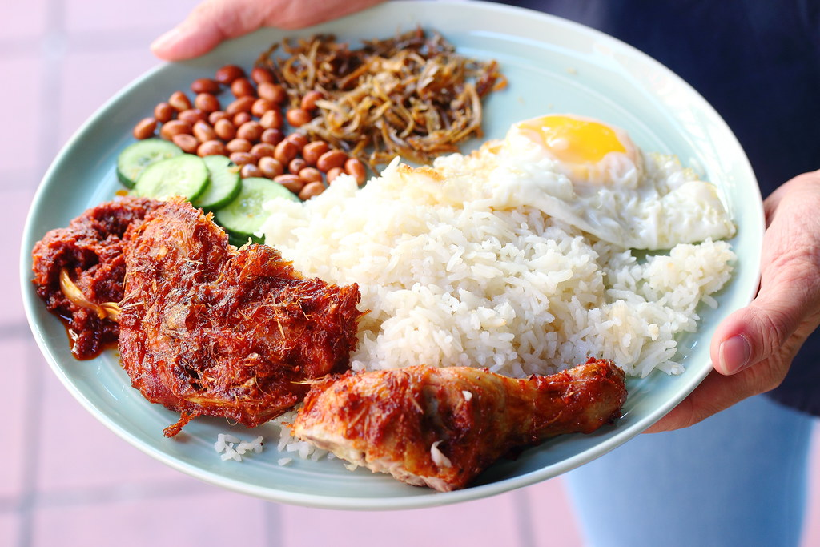
BACKGROUND
01

Slide 4
Problem Statement
The goal of this project is to build an image classifier for Singapore’s 12 most famous hawker food using convolutional neural network (CNN) and transfer learning.
Performance of our models will be evaluated using the accuracy score (i.e. ratio of number of correct predictions to the total number of input images) for our test set (i.e. hold-out set of images to prevent data leakage)

Slide 5
Why Hawker Food?
Source of pride for Singaporeans from all walks of life
Reflection of our heritage and plays an important role in our lives
Image classifier can work in tandem with the Ministry of Culture, Community and Youth (MCCY) and the National Heritage Board (NHB)’s campaign to solicit food images via online photo contributions to document our heritage
Recent successful inscription into UNESCO Representative List of the Intangible Cultural Heritage of Humanity may entice tourists to try our hawker food
Given its wide variety, having an image classifier will allow them to better learn, differentiate and appreciate our hawker food/culture

Slide 6
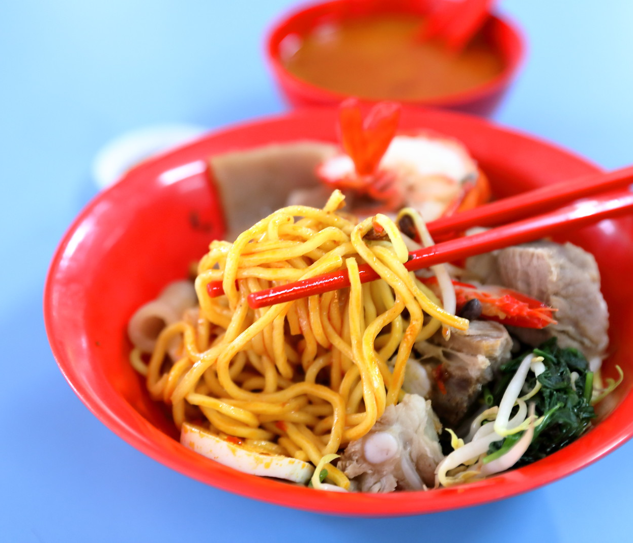
DATA
02

Slide 7
Images scrapped from Google due to lack of available dataset
 | Training | Validation | Test
Images per class | 1,000 | 200 | 200
Total images | 12,000 | 2,400 | 2,400
Validation set for hyperparameter tuning
Test set for final evaluation of model accuracy to prevent data leakage

Slide 8
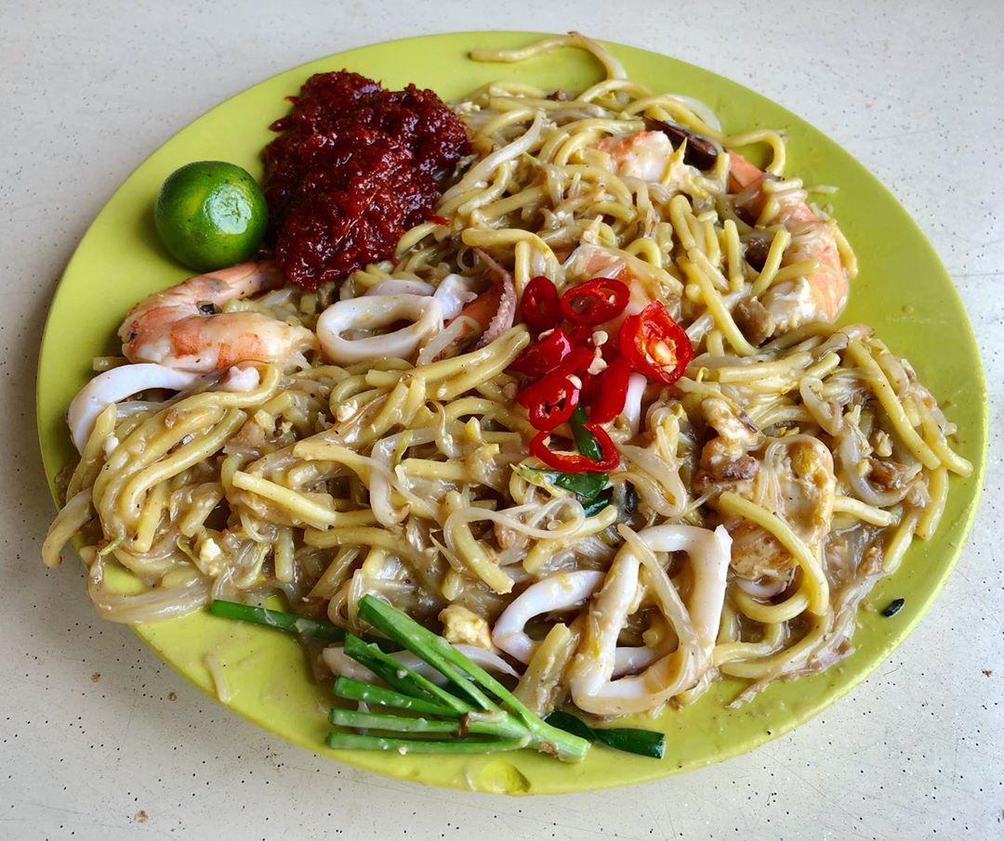
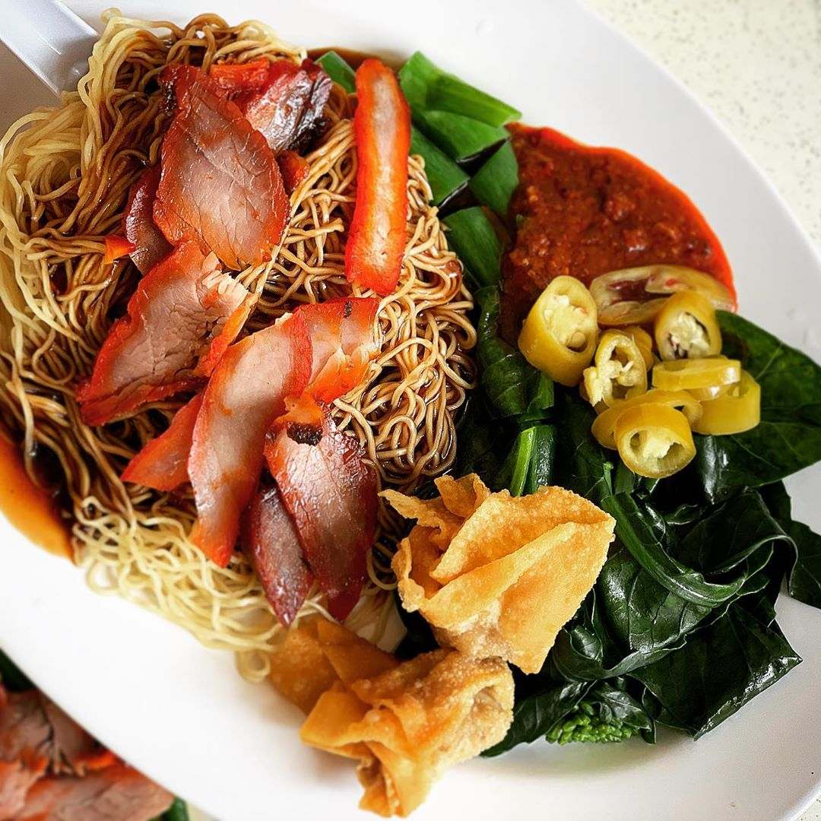
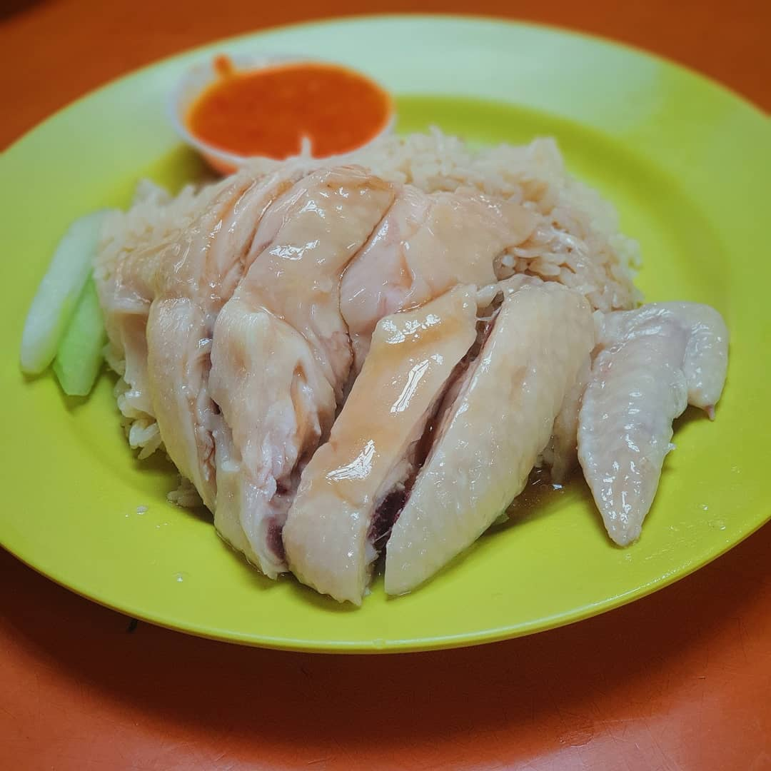
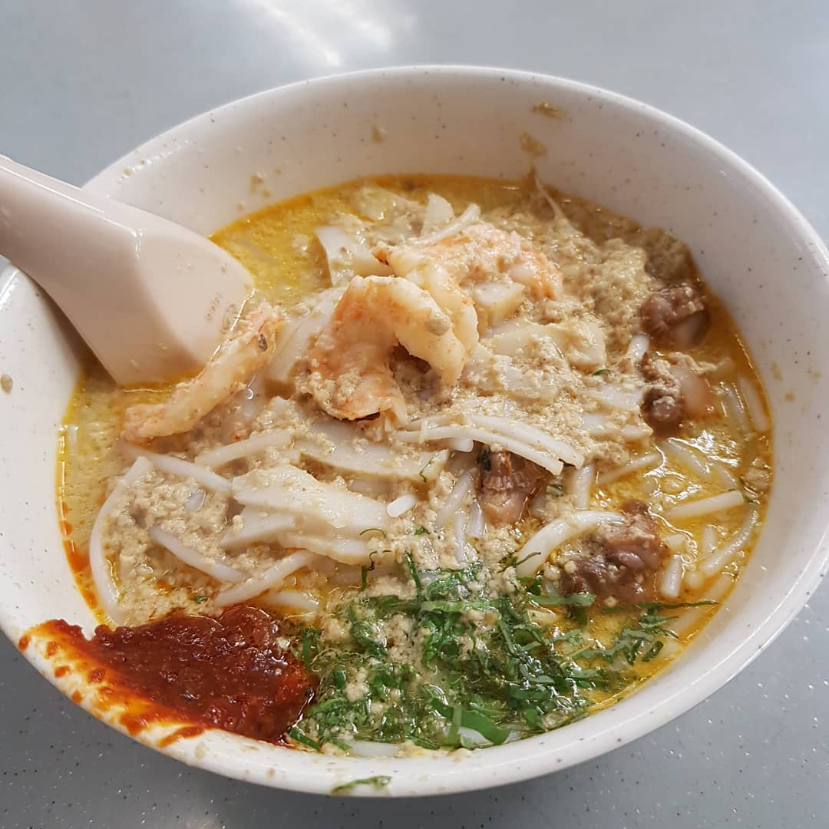
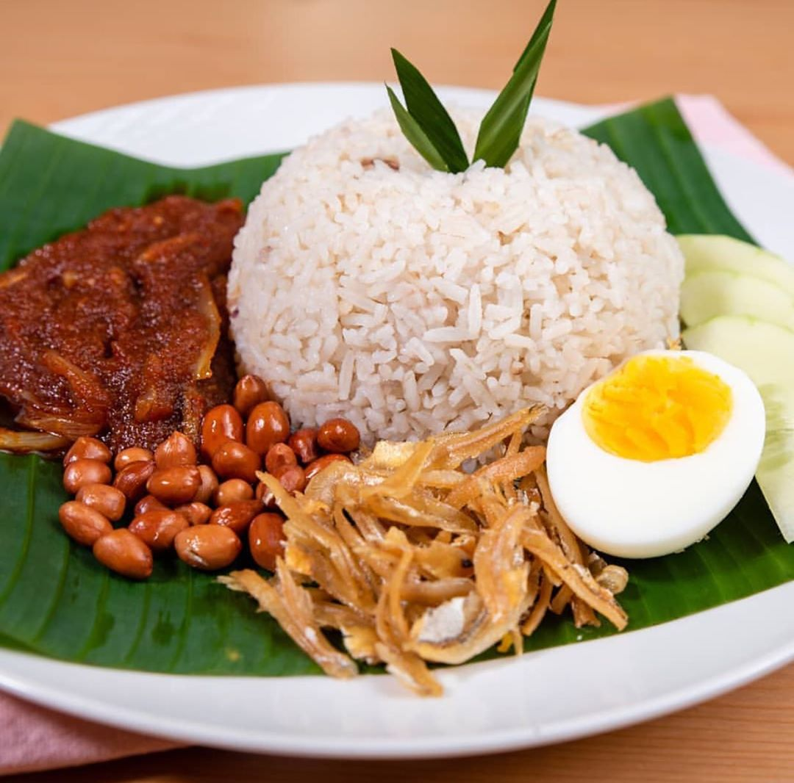
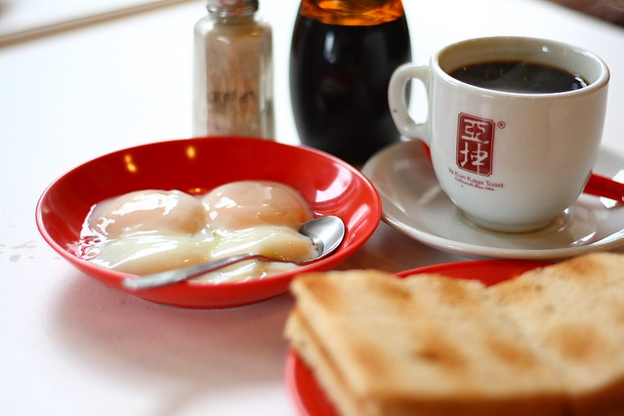
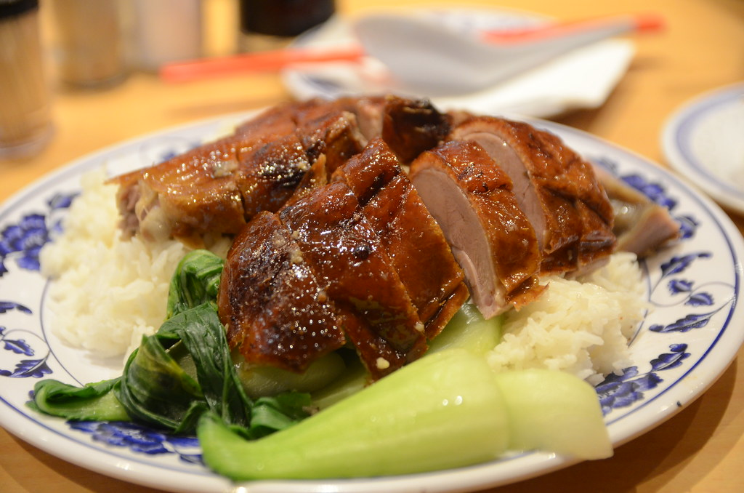
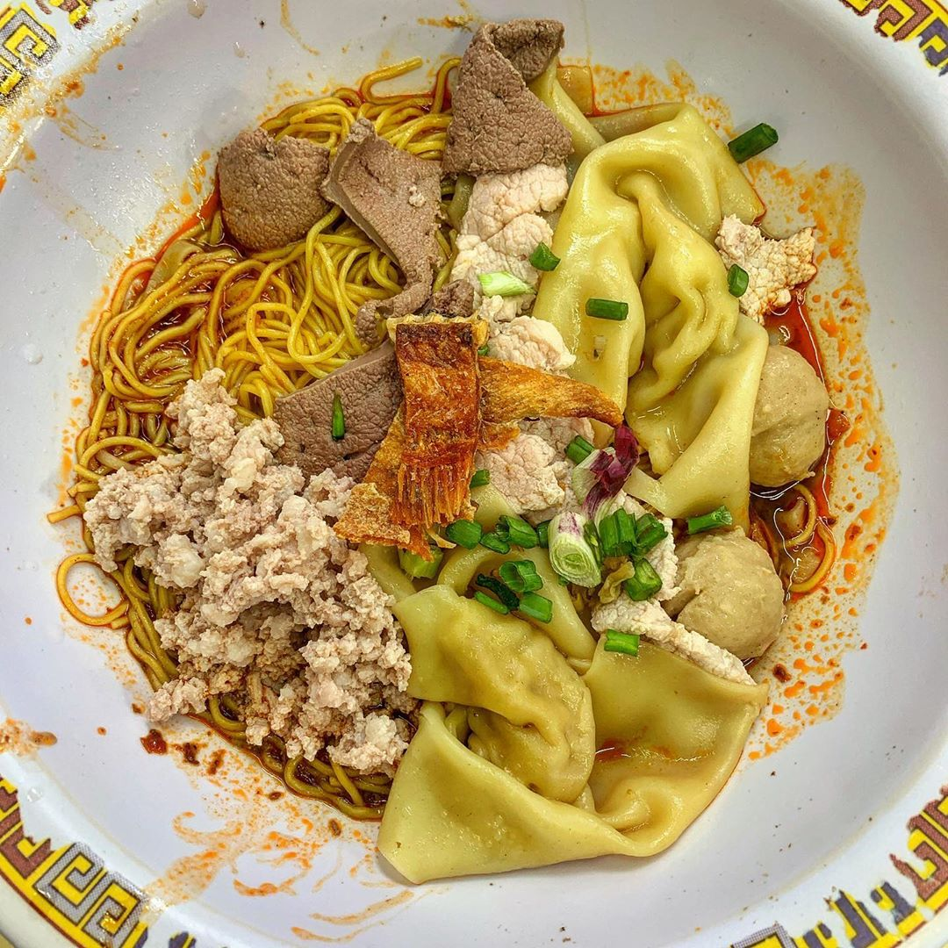
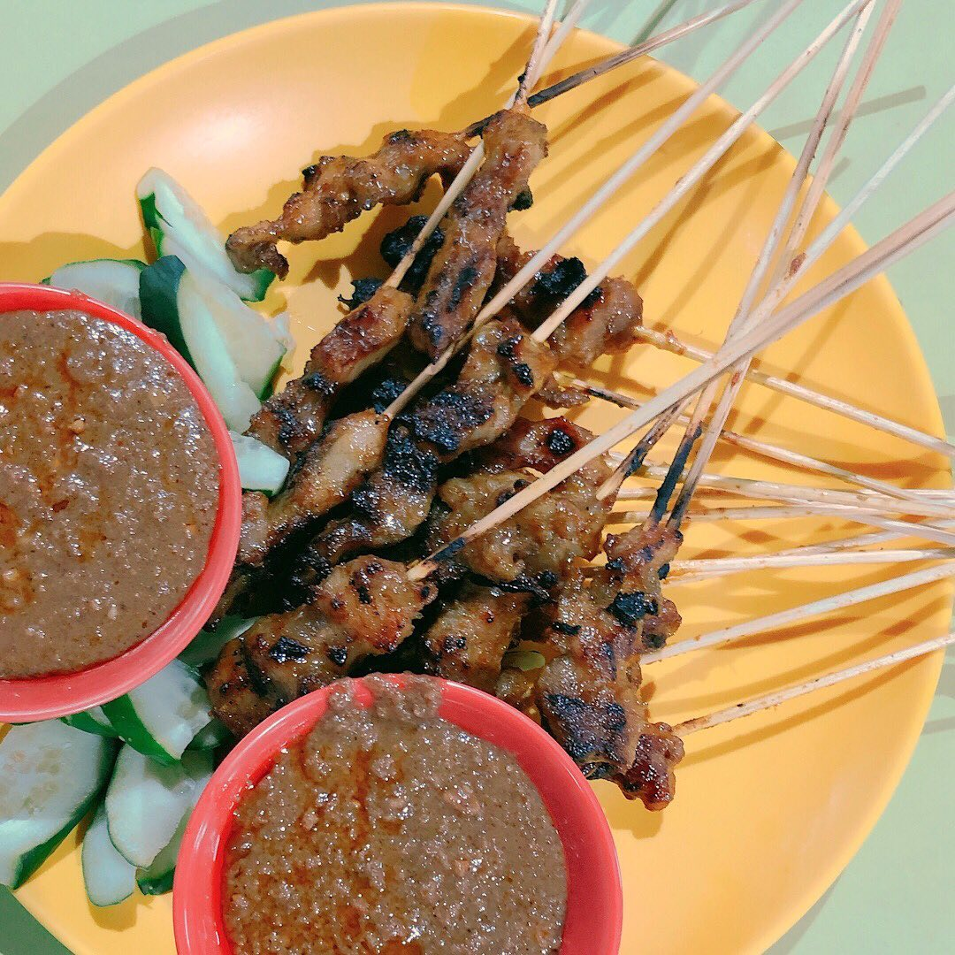
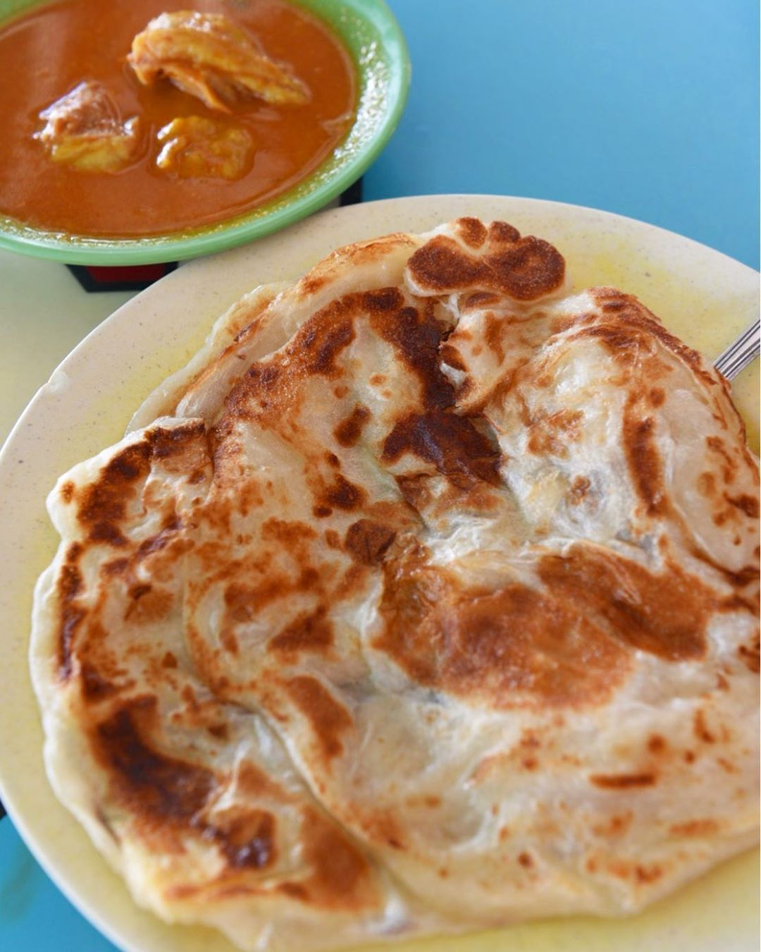
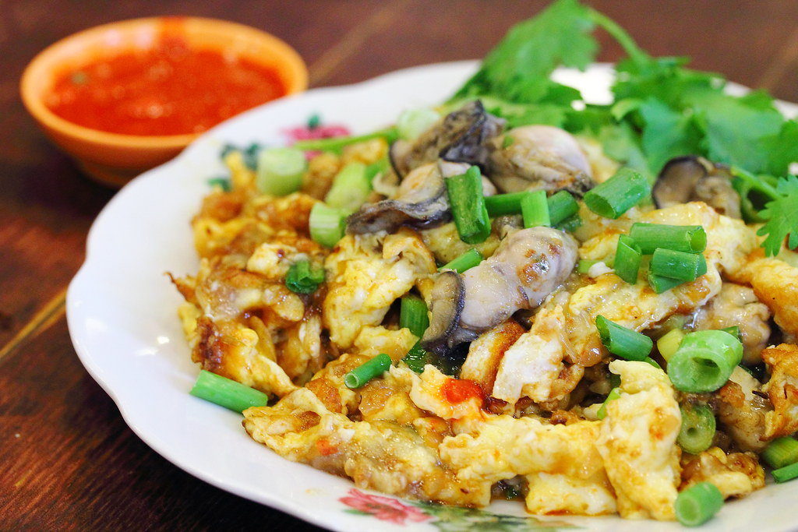
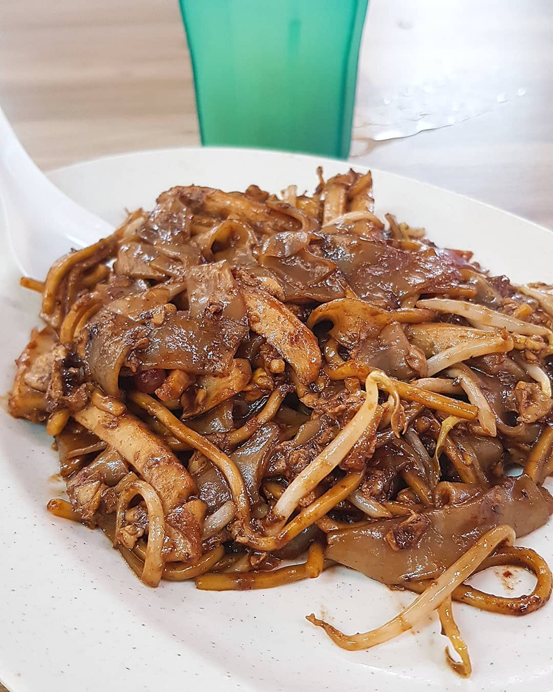
12 Classes of Hawker Food
Fried Hokkien Mee
Wanton Mee
Chicken Rice
Laksa
Nasi Lemak
Kaya Toast and Egg
Roast Meat Rice
Bak Chor Mee
Satay
Roti Prata
Oyster Omelette
Char Kway Teow

Slide 9
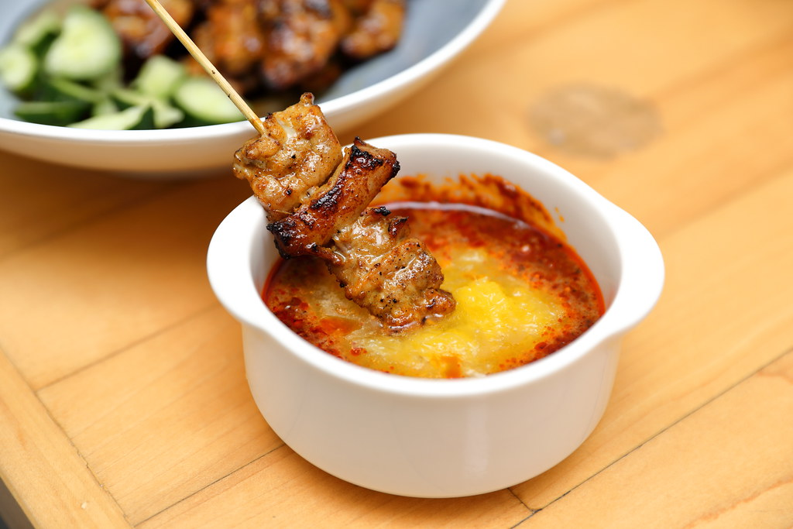
MODEL SETUP
03

Slide 10
Deployed 2 main groups of models for image classification
Group 1: Self-built convolutional neural network (CNN) model with its respective layers (e.g. Conv2D, MaxPool2D, Dense)
Transfer learning using pre-trained models (i.e. MobileNetV2, VGG16 and ResNet50) for feature extraction and subsequent prediction

Slide 11
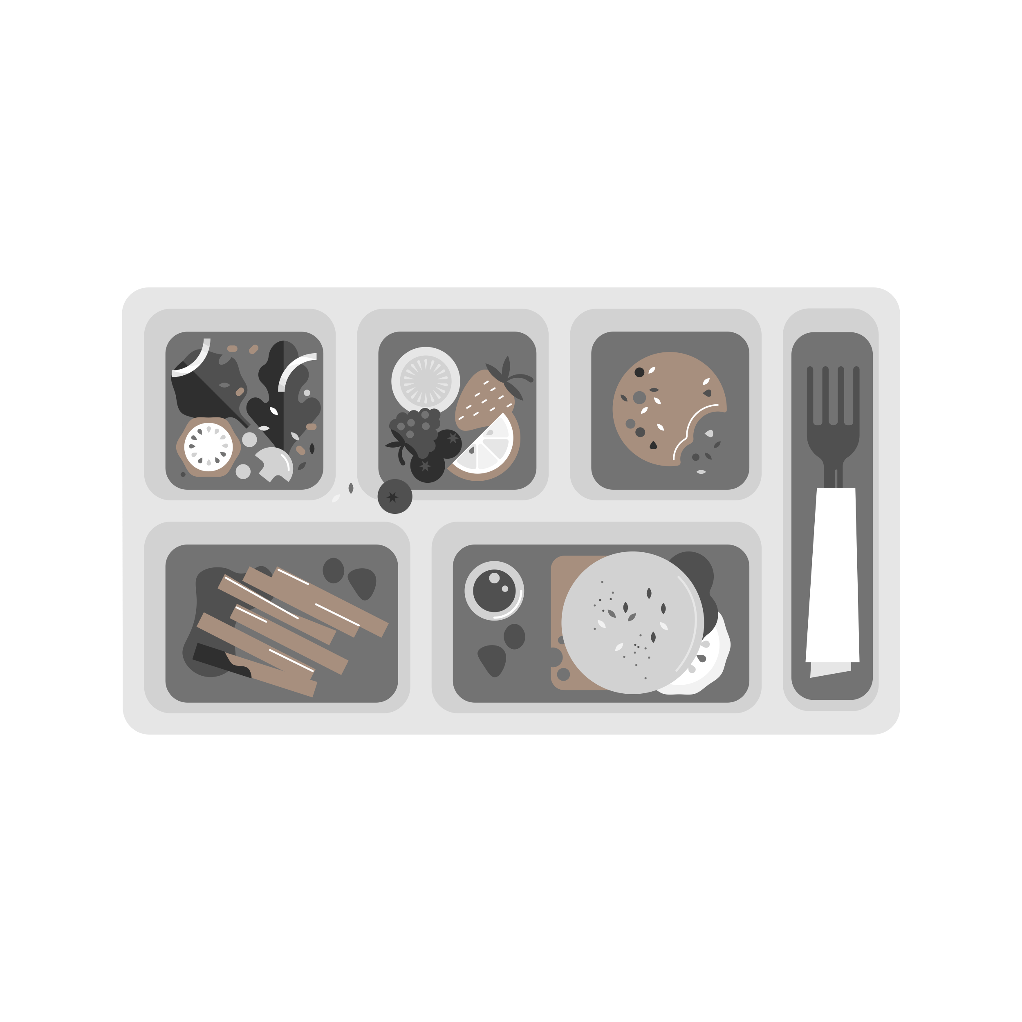


Overview of our modeling approach
TRAINING FROM SCRATCH (GRP 1)
CONVOLUTIONAL NEURAL NETWORK (CNN)
CHICKEN RICE ✓
NASI LEMAK ✗
LAKSA ✗
LEARNED FEATURES
80%
10%
2%
TRANSFER LEARNING (GRP 2)
CHICKEN RICE ✓
NASI LEMAK ✗
LAKSA ✗
TRAINED ON IMAGENET
FINE-TUNE NETWORK WEIGHTS
PRE-TRAINED CNN
CLASSIFIER LAYER

Slide 12
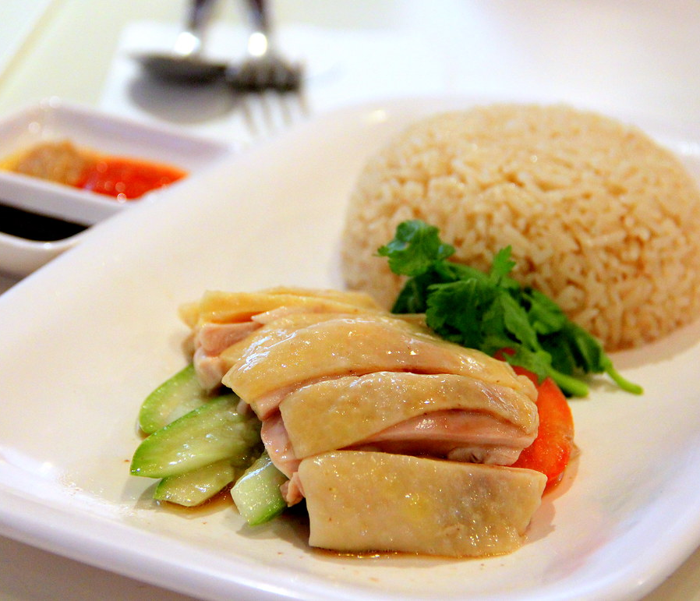
MODEL EVALUATION
04

Slide 13
ResNet50 model chosen as it has highest test accuracy
 | Baseline | CNN | MobileNetV2 | VGG16 | ResNet50
Training Accuracy | - | 77.2% | 76.8% | 88.9% | 86.1%
Validation Accuracy | - | 75.3% | 74,8% | 81.1% | 82.2%
Test Accuracy | 8.3% | 76.4% | 73.4% | 80.8% | 82.8%
Test accuracy chosen as evaluation metric as evaluated on test set (i.e. hold-out set)
This ensures there is no data leakage

Slide 14
ResNet50 model works well to classify images into respective classes
Highest accuracy class is almost 100% spot on (i.e. Kaya Toast and Egg with 197/200 images correctly classified
Even lowest accuracy class (i.e. Bak Chor Mee) has 146/200 images correct

Slide 15
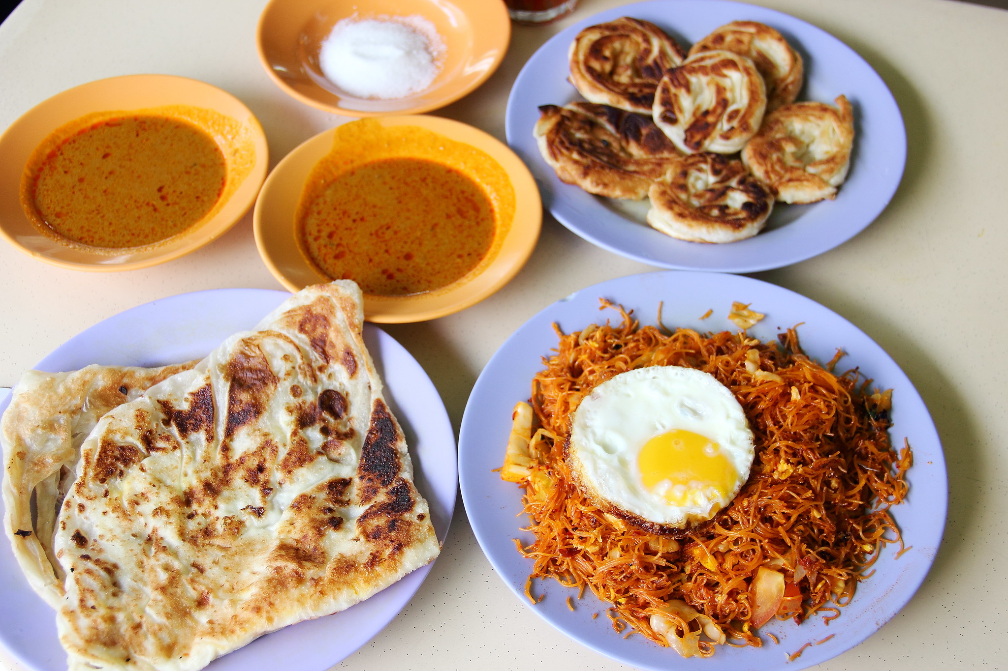
LIMITATIONS
05

Slide 16
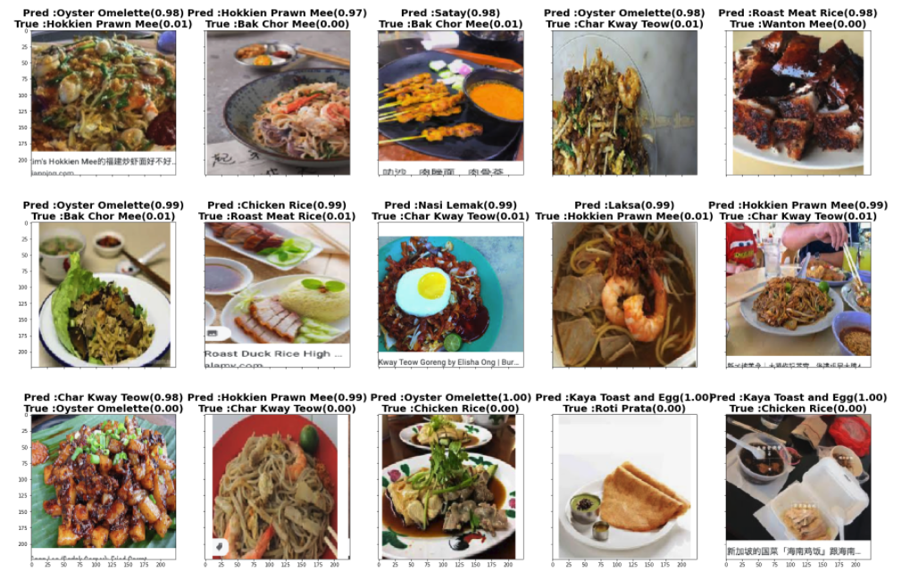
Chosen model struggles slightly with classifying noodle-related images
From our confusion matrix earlier, our ResNet50 model tends to struggle with noodle-related images (e.g. 17 Bak Chor Mee images inaccurately predicted as Laksa).
This phenomenon is also observed in other models that we have built.

Slide 17
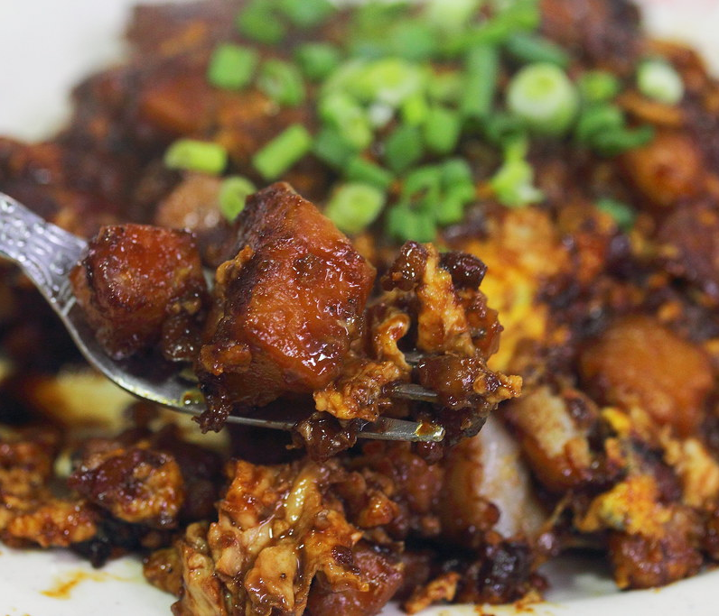
FUTURE WORK
06

Slide 18
Ways to expand/improve current scope of project
Re misclassification of noodle-related images, to collect and train our models on even more images so that they get better at recognising and predicting features
Expand the coverage of our image classifier to include more hawker food classes (i.e. increase comprehensiveness of classifier)
In terms of practical usage, we can collaborate with MCCY and NHB to deploy our model in their Our Singapore Heritage website to ensure that photo contributions are accurately tagged.
To facilitate tourists in distinguishing between the various hawker food classes, we can also work to deploy our image classifier in an app so that they can easily upload images for prediction

Slide 19
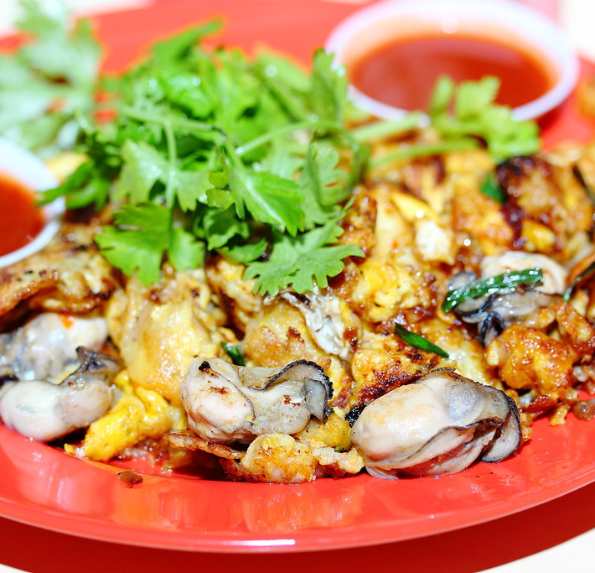
THANKS!
Any questions?

